Slide 1
Digital Portfolio
STUDENT NAME: VENDIMUTHAIYA M
REGISTER NO AND NMID: 2426J0131 AND B9B599DC525697C860B495D2C9749BA3
DEPARTMENT:2ND BSC IT
COLLEGE: PPG COLLEGE OF ARTS AND SCIENCE/BHARATHIYAR UNIVERSITY

Slide 2
PROJECT TITLE
SIMPLE PORTFOLIO

Slide 3


AGENDA
Problem Statement
Project Overview
End Users
Tools and Technologies
Portfolio design and Layout
Features and Functionality
Results and Screenshots
Conclusion
Github Link
3/21/2024 Annual Review

Slide 4

PROBLEM STATEMENT
A digital portfolio serves as a modern solution to showcase an individual’s skills, projects, and accomplishments in a structured and visually appealing way.
In today’s competitive IT industry, traditional resumes and documents often fail to reflect practical capabilities.
Problem Identified:
Lack of interactive and easily accessible platforms for students to showcase their work.
Limited means to demonstrate real-world IT skills to potential employers or academic evaluators.
Static resumes do not effectively highlight creativity or technical skills.

Slide 5

PROJECT OVERVIEW
The Digital Portfolio project is a web-based portfolio system designed and developed using front-end and back-end technologies.
It is a personal website or application that showcases:
Educational background
Technical skills
Academic and personal projects
Certifications
Contact information
This portfolio is designed to help students present themselves more effectively to recruiters, internship providers, and academic institutions.

Slide 6

WHO ARE THE END USERS?
The primary users or beneficiaries of the digital portfolio system include:
🎓 Students To showcase skills, coursework, and project work to future employers.
🧑‍💼 Recruiters / Hiring Managers To assess candidate capabilities beyond traditional resumes.
🧑‍🏫 Academic Staff / Project Evaluators For evaluating students' final year projects, assignments, or overall progress.
💼 Freelance Clients If students wish to offer freelance services, portfolios help build trust.

Slide 7

TOOLS AND TECHNIQUES
The portfolio was developed using the following technologies:
Frontend Technologies:
HTML5 – Structure and content
CSS3 – Styling and layout
JavaScript – Interactivity and responsiveness
Backend (if applicable):
PHP or Node.js – Server-side scripting (optional)
MySQL – For storing contact form data or dynamic content
Additional Tools:
Visual Studio Code – Code editor
GitHub – Version control and hosting
Canva/Figma – UI design (if used)

Slide 8
POTFOLIO DESIGN AND LAYOUT
The layout of the digital portfolio is clean, professional, and user-friendly, divided into multiple sections:
Home Page – Brief intro and profile image
About Me – Education, interests, goals
Skills – Technical and soft skills displayed visually (e.g., progress bars)
Projects – Screenshots, links, and brief descriptions of completed projects
Contact – Form or details for recruiters to reach out
Certifications – Online courses, workshops attended
The design follows a responsive layout that works on mobile, tablet, and desktop devices.
8

Slide 9
FEATURES AND FUNCTIONALITY
Key features of the digital portfolio include:
✅ Responsive Design – Works seamlessly across all device types ✅ Interactive UI – Engaging user interface with animations or hover effects ✅ Downloadable Resume – Option to download a PDF version of the resume ✅ Live Project Links – Redirects to GitHub or hosted projects ✅ Contact Form – Enables direct communication ✅ Custom Styling – Personalized colors, fonts, and themes to reflect personality ✅ Version Control – Hosted on GitHub for easy updates and collaboration

Slide 10
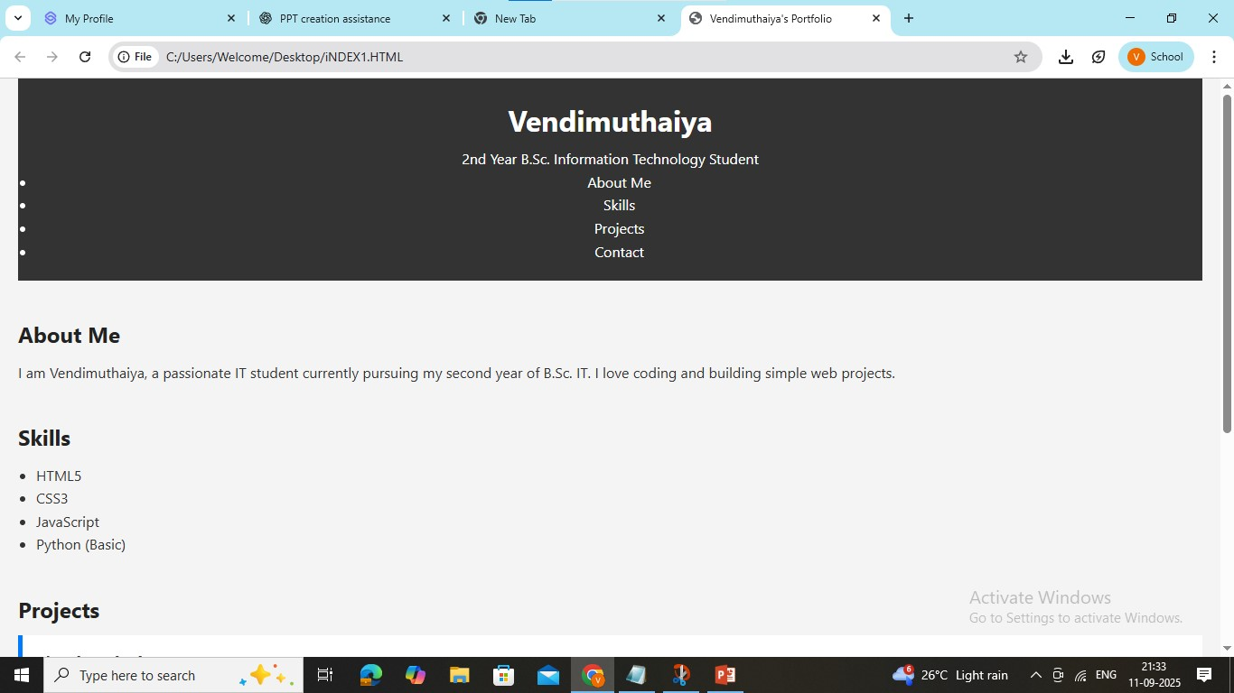

RESULTS AND SCREENSHOTS
3/21/2024 Annual Review
10

Slide 11
CONCLUSION
The Digital Portfolio project serves as a bridge between academic learning and professional opportunities.
It empowers students to:
Take ownership of their personal brand
Present themselves effectively in the digital world
Gain confidence while applying for jobs or internships
In the IT industry, where skills and creativity matter most, a digital portfolio is no longer optional—it’s essential.
This project is a step forward in making students future-ready and tech-savvy.
11

